Slide 1
EMMAS AP ART
emma daugherty’s breadth and concentration 2018-19

Slide 2
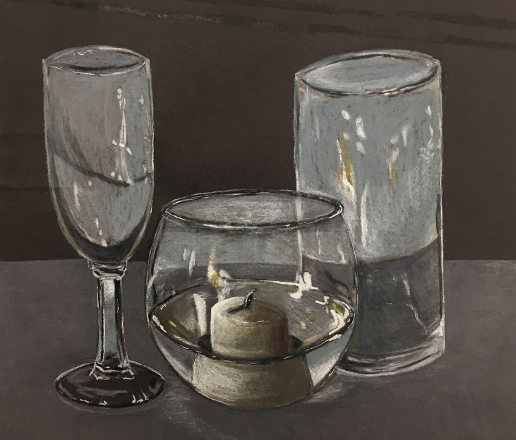
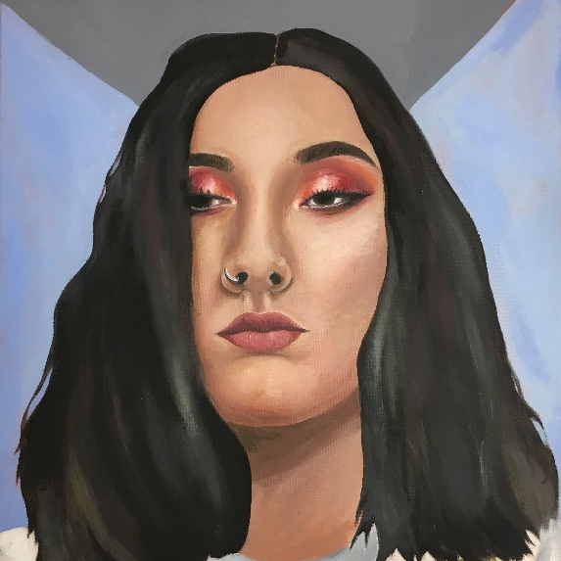
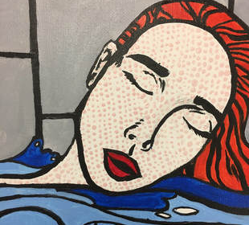
BREADTH
A breadth in art is a series of pieces encompassing several different styles, themes, and mediums

Slide 3
VANILLA
The prompt for this piece was reflection, or reflective surfaces. This piece was easy for me to come up with because I knew I wanted to do something with meditation and therapeutic practices which has become a large part of my life. So I drew a candle used for a peaceful atmosphere in some glasses with water, used to reflect the light beautifully in a darker room.

Slide 4
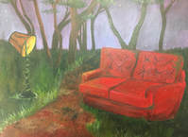
RELAXED
The theme for this project was an everyday object in an place you wouldn’t normally find it. I executed this piece by putting pieces of furniture from a living room in a forest. To blend to the two contrasting things I put roots and leafy vines through the structure of the couch and around the pole of the lamp.

Slide 5
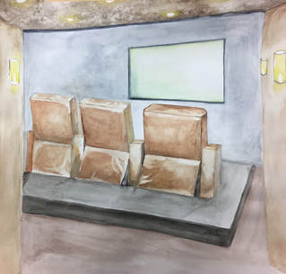
INTERIOR SPACES
This project started with the idea to depict the inside of a room or closed space. My composition was an home theatre.

Slide 6
SELF PORTRAIT
My self portrait was done with oil paint. To create this piece I pushed the dark shadows to try to make a piece with lots of value, as well as lots of color.

Slide 7
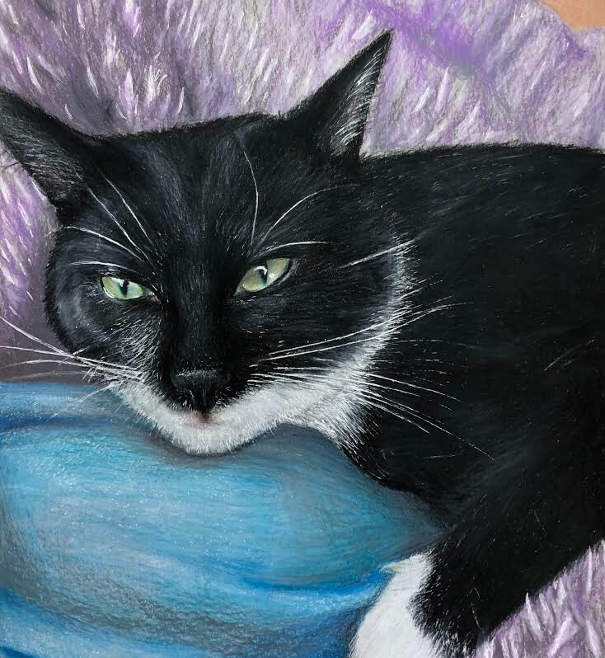
PET PORTRAIT
I did this piece with prismacolor pencils. This piece is a portrait of my friend Wil’s cat. This piece was really fun and satisfying to create because the little details in the fur were time consuming to achieve but came out really well.

Slide 8
LANDSCAPE
My landscape project was done in oil, I created this piece by carefully layering each part of the scene. I started by blending the colors in the background to create a sunset look and then trees and so on.

Slide 9
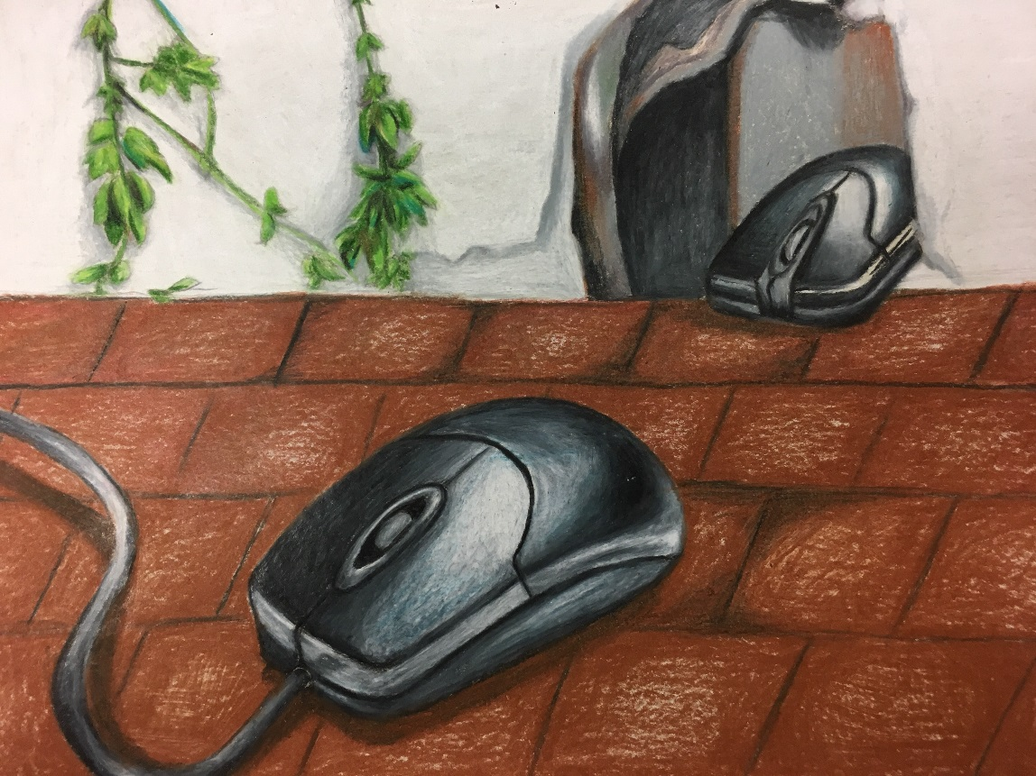
NATURE TURNS MECHANICAL
For the nature turns mechanical project I thought there was potential for a pun, so I created a piece playing on a computer mouse, living as a mouse in a mouse hole. This piece was done in prismacolor pencil, and it was very challenging to get a convincing reflective surface on the mouse face. However, overall this piece went very well.

Slide 10
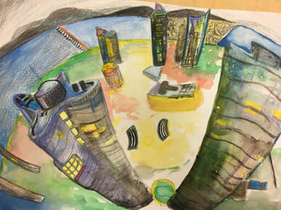
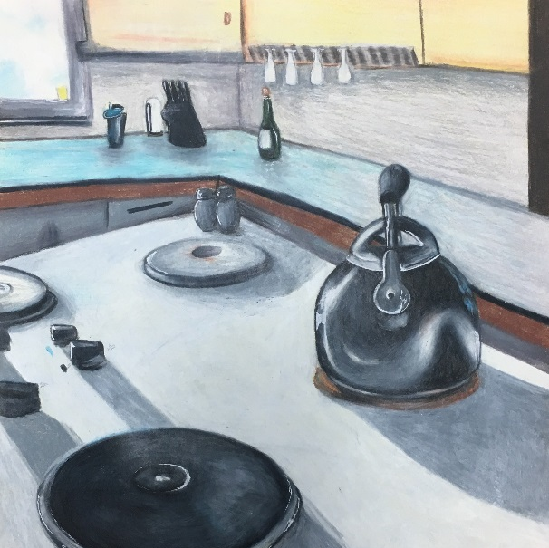
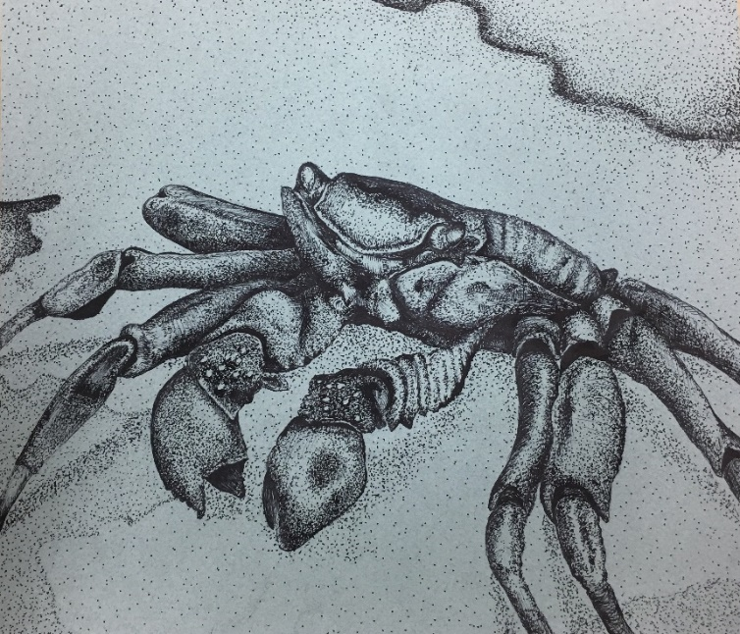
CONCENTRATION
My concentration theme Is fears and phobias, that either I have or someone close to me has, and then transforming them into something not scary.

Slide 11
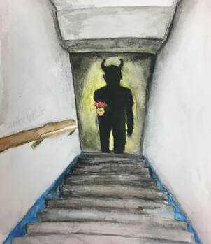
DECEPTION
My first concentration piece is the fear of the unknown, or more commonly seen as the fear of darkness. This fear was somewhat an icebreaker into my concentration because I believe It’s a fear that a lot of people suffer from in one form or another. I created this with watercolor paint and pencils.

Slide 12
WARPED
My second concentration is the fear of heights, I wasn’t sure how I could transform this piece into something more beautiful, so I tried to add lots of color and bleeding Avant Garde style lines, to compensate. This piece is more specific to me because to fear of heights and falling has been the more consistent fear I’ve had.

Slide 13
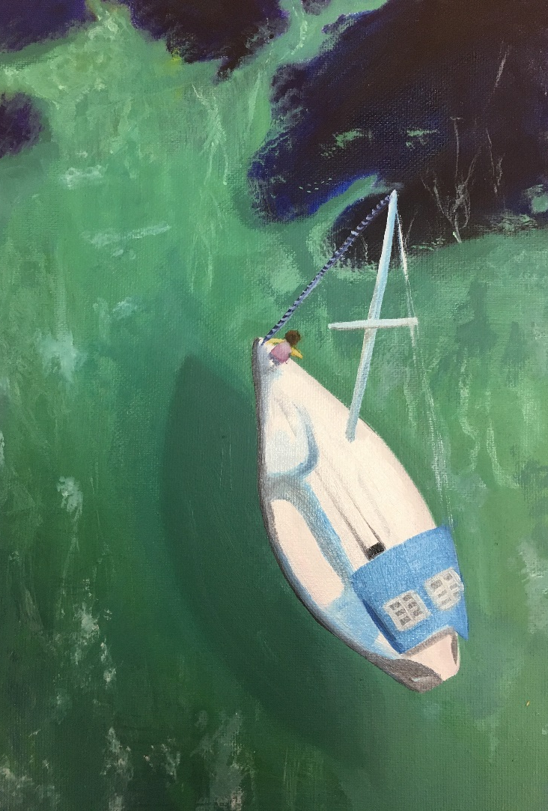
AT SEA
This piece was created with oil paint. The concept for this fear was fear of open water, or over water traveling. I’ve only been uncomfortable with large bodies of water in the past, but a close friend of mine suffers from a more intense form of this fear, and is unable to be on a boat for long period of time.

Slide 14
DON’T TOUCH
This piece is on the fears that surface during childhood, and how things you’re told not to do or things you’re told to believe as a child can follow you into adult life, changing the way you see things.

Slide 15
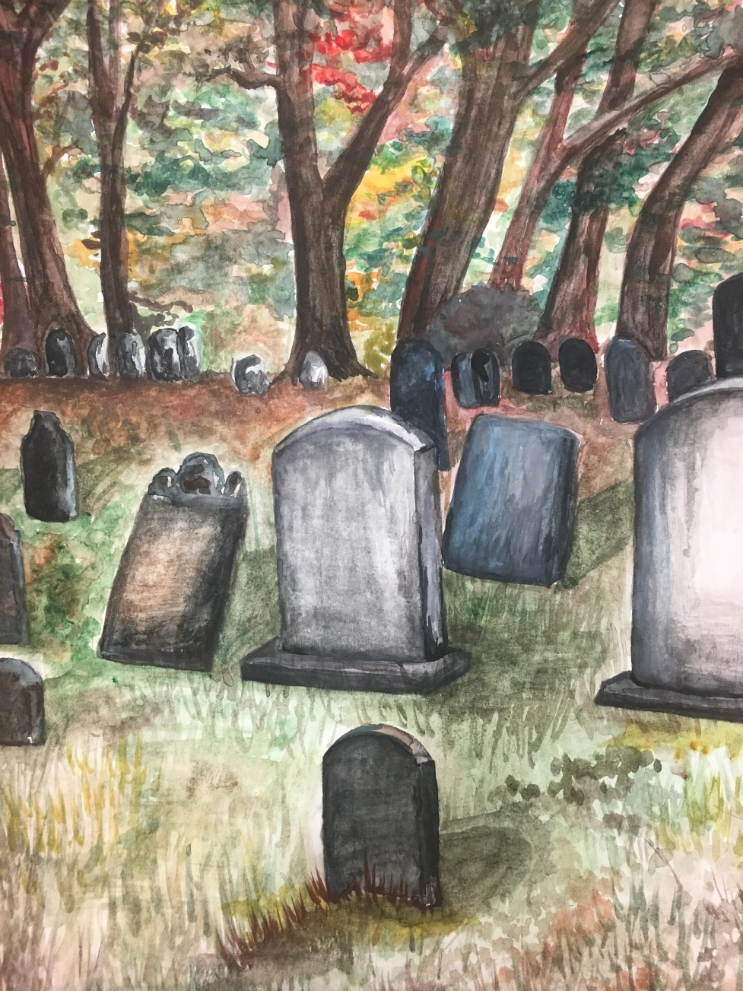
WALK SLOW
This fear, is the fear of death, whether its your own death or losing the people closest to you. A lot of people fear death as it somewhat correlates to the fear of the unknown. I tried making this piece more beautiful by adding lots of color, and giving this concept a soft watercolor effect made the imagery less haunting.

Slide 16
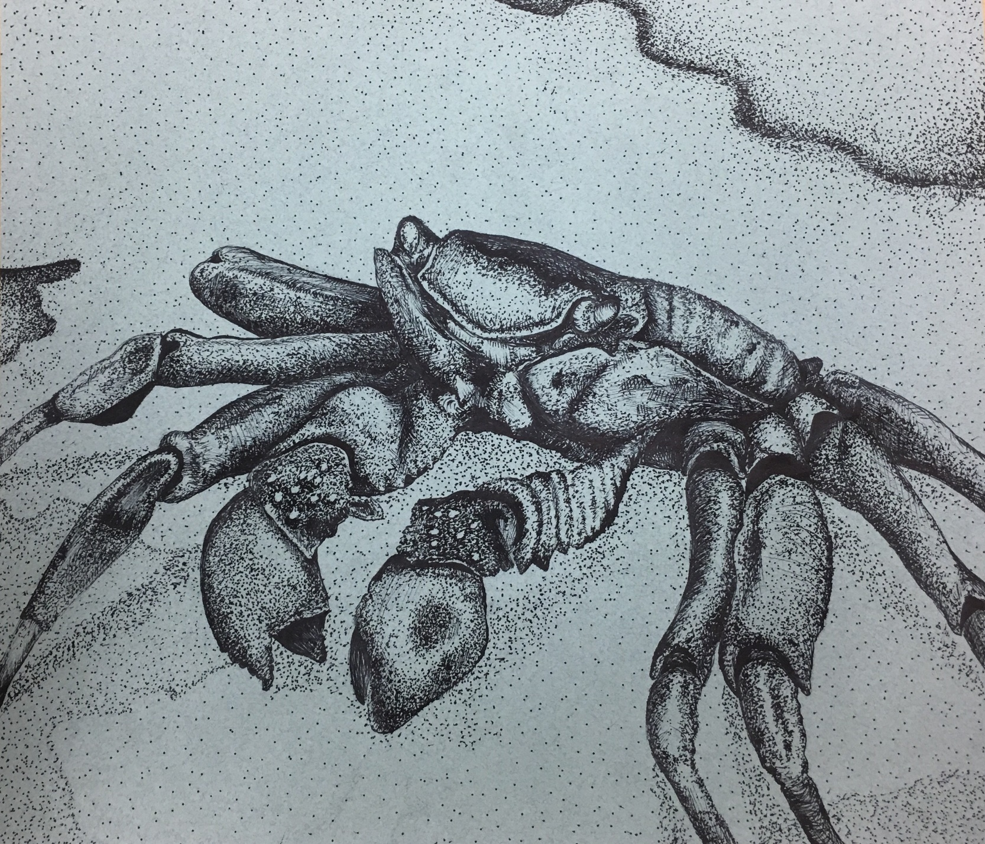
ARACHNOPHOBIA
This fear is more specific than I wanted to go with my concentration, but I think it added to the variety of styles. The pen and ink was a challenge for all of the details and shadows that I wanted to create.

Slide 17
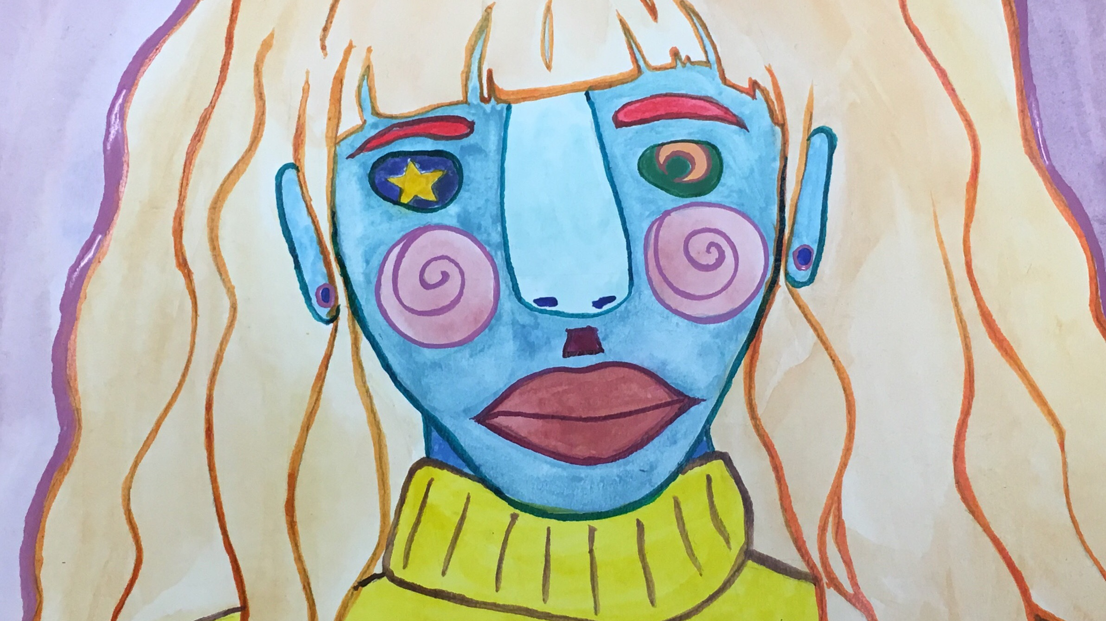
ALIENATION
For this next piece, I felt that after my more on the nose fear (arachnid) that I should do a deeper, more meaningful piece. This is the fear of being cast away, seen as less than others, or being separated from other people due to the way you look, or the way you’re perceived.

Slide 18
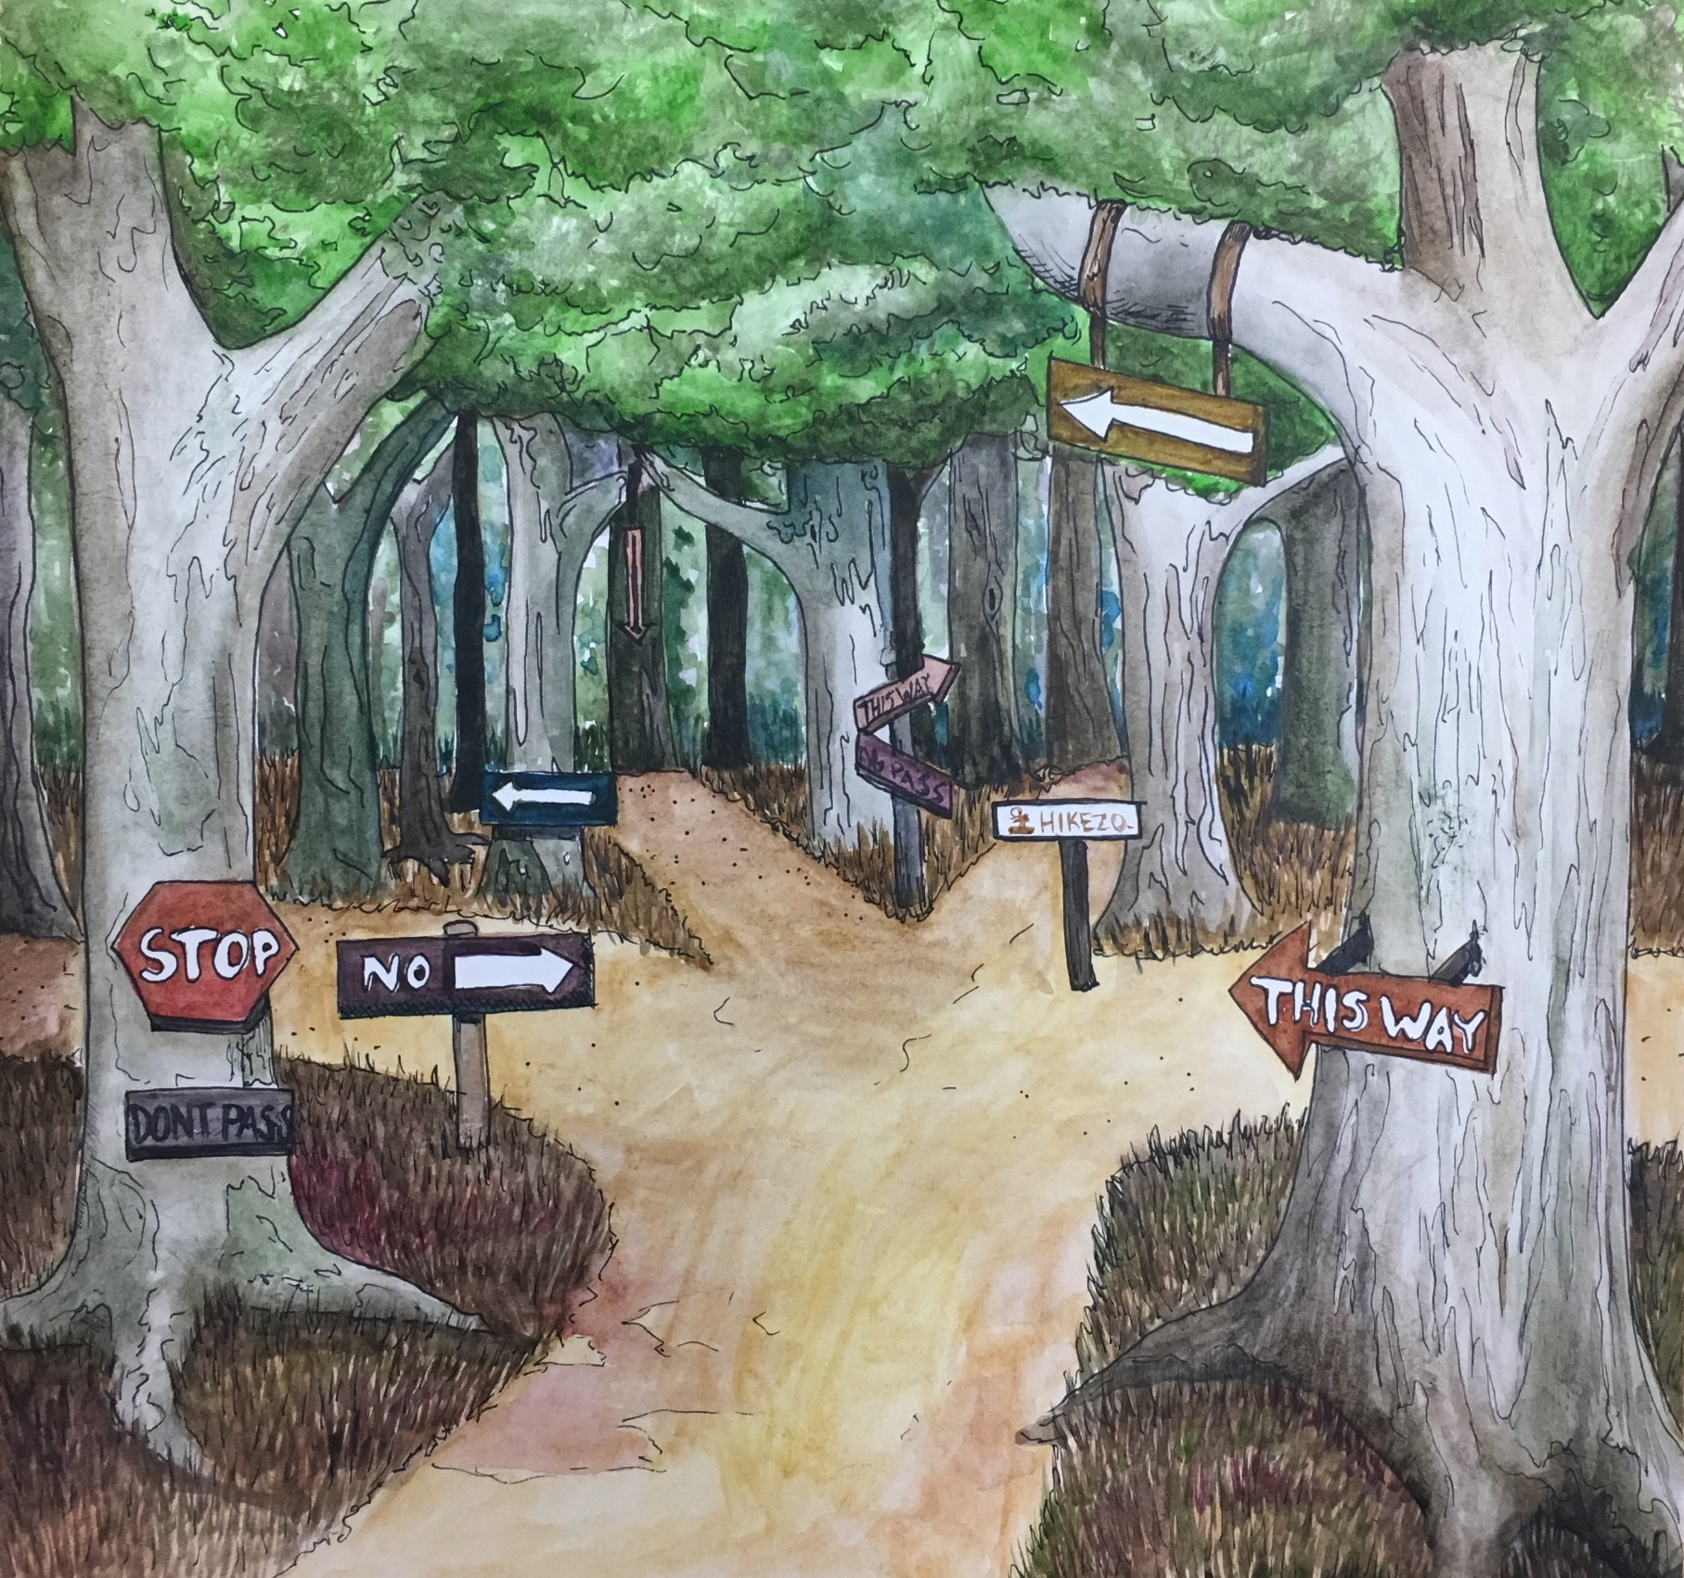
STOP, GO, TURN
This piece represents the fear of getting lost, either literally, but more probably mentally. For me this piece represents losing who you are or losing your values and self worth as you age. I did this piece in what I call children’s book illustration style, to make it subtly apparent that this loss of self begins at every age, and you can forget what you want out of life from childhood.

Slide 19
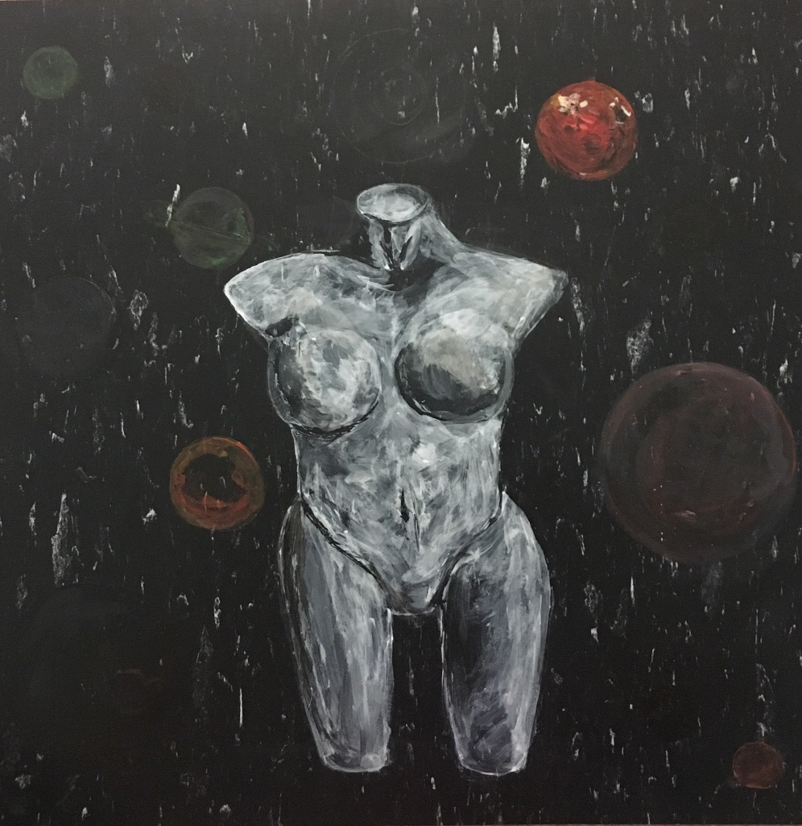
DISPERSE
This piece is touching on the fear of exposure, or the fear of being known more than you’re ready for. Intimacy and full expulsion of who you are can be terrifying, but making the result of working for honesty beautiful was easy. For the concept of this piece I wanted it to represent what it could look like to have already embraced transparency, hence the nudeness, and space visuals depicting openess.

Slide 20
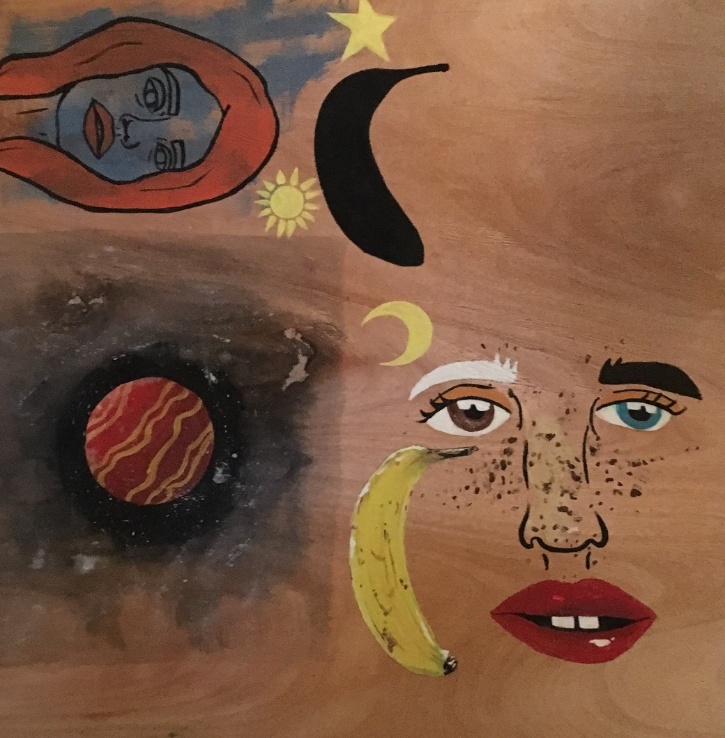
THE CHAOS COLLAGE
I had this piece in mind during the entire process of my concentration, but I felt that I should make it my last piece. This piece represents lack of conformity, and fearing the results of not meeting the status quo. This piece was created with acrylic paint of wood brick board.

Slide 21
THANK YOU!

